Slide 1
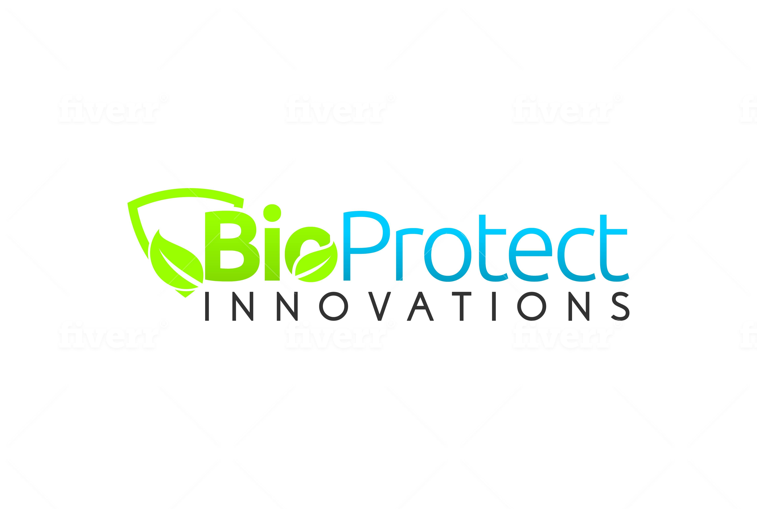

Slide 2
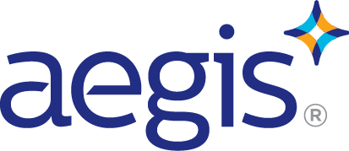
24/7
365
Surface Protection
Safe
Durable
Effective

Slide 3
Protecting Textiles With AEGIS
Annual application
Protects from mould bacteria and related odours
Extends life of fabric as microbes are a significant part of material degredation
USED by manufacturers like NIKE, REEBOK, SOLOMON and more

Slide 4
Textile Washing Protocol
Dry Weight | AEGIS Concentrate | Water
1 kg | 3ml | 1 gallon
2 kg | 6 mL | 1 gallon
5 kg | 15 mL | 1 gallon
10 kg | 25 mL | 1 gallon
20 kg | 50 mL | 1 gallon
Weigh the laundry
Measure AEGIS concentrate using syringe
Add to one gallon container
Pour into final rinse at highest water level
Protect Technologies Sells a one litre container of AEGIS for or $1250 Cdn

Slide 5
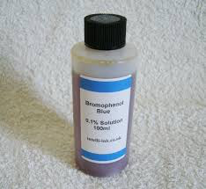
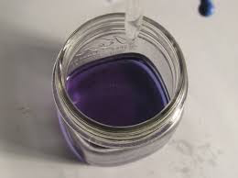
Test Protocol – confirmation of application
Throw in a white cotton cloth in with the wash
After drying, spray with Bromo-phenol Blue
Rinse
If the cloth is blue, AEGIS is there, if it washes out there is a process problem

Slide 6
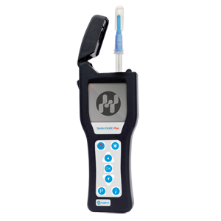
Test Protocol – confirmation of effect
Hygiena ATP meter
  professional grade instrument used to measure how clean surfaces are. Ranges can be set, but generally speaking “0” is sterile, anything over “30” is a fail.

